Slide 1
TEAM TURING
DEMO 2

Slide 2
Team Members
• Kyle Pretorius Role: Back End, Database
• Ulrik de Muelenaere Role: Full Stack
• Darius Scheepers Role: Back End
• Richard Dixie Role: Front end, Database
• Tristan Rothman Role: Front End, Slack and Project Management
• Sewis van Wyk Role: Back end, Documentation

Slide 3
Project Description
The project helps increase surveillance in nature reserves by letting users be a presence by using our app. This app will record the area the users have monitored. It can suggest routes of areas that haven’t been monitored recently, allow them to log notes and pictures of any suspicious behaviour and send alerts. The users will be rewarded with blockchain tokens.

Slide 4
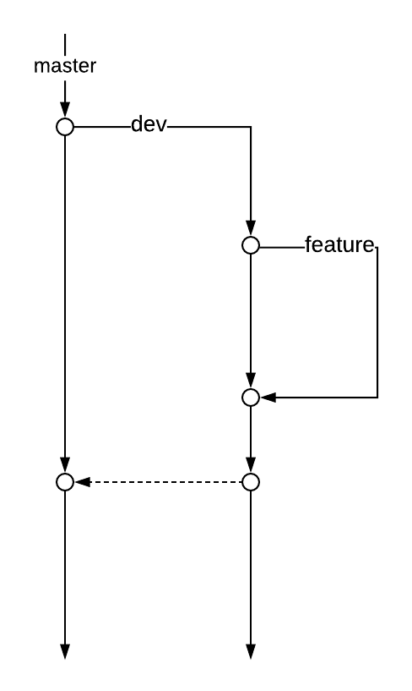
Git structure

Slide 5
Use cases

Slide 6
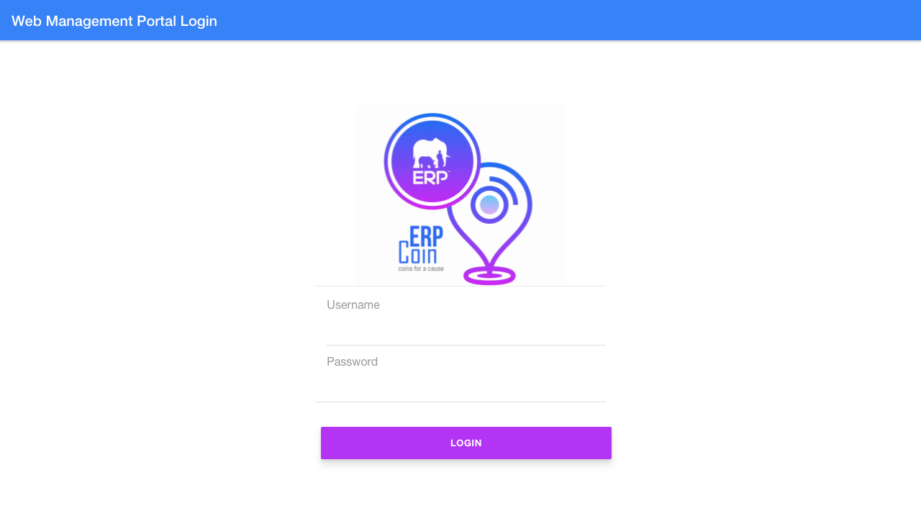
1 Web Management Portal LogIn

Slide 7
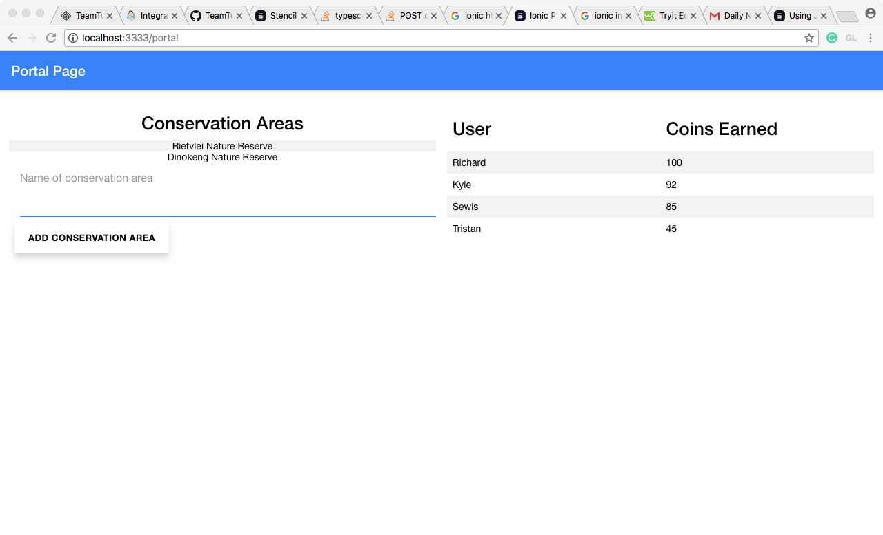
2 Web Management Portal View User Conservation Areas and Leaderboard

Slide 8
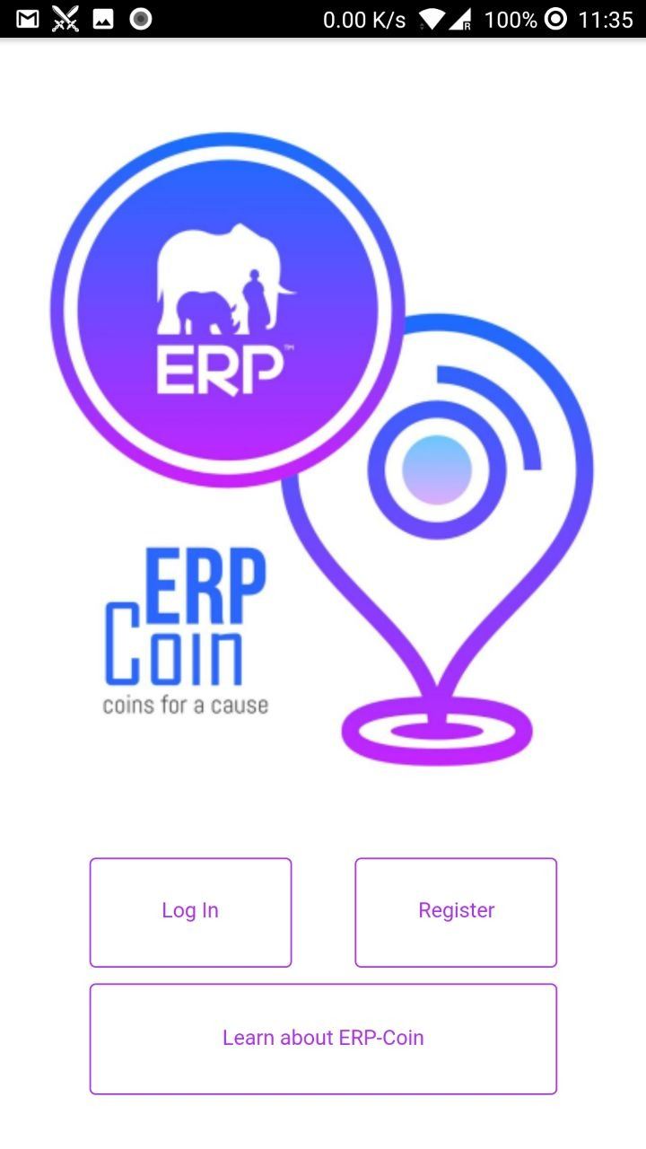
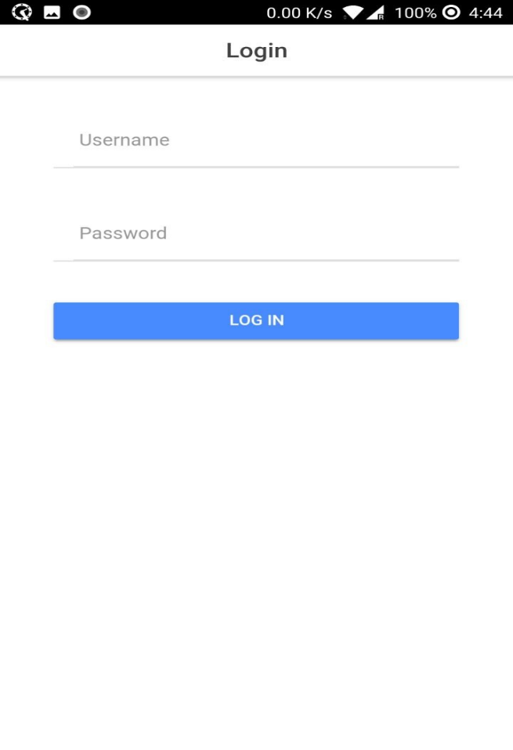
3 Mobile Application User Login

Slide 9
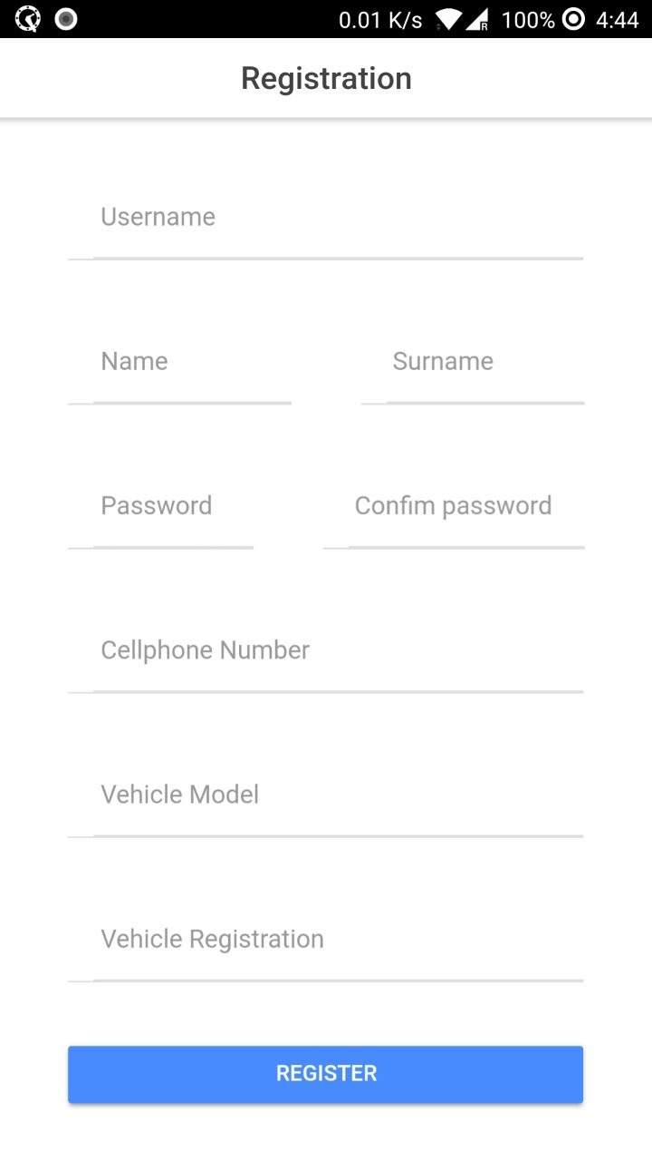
4 Mobile Application Create User

Slide 10
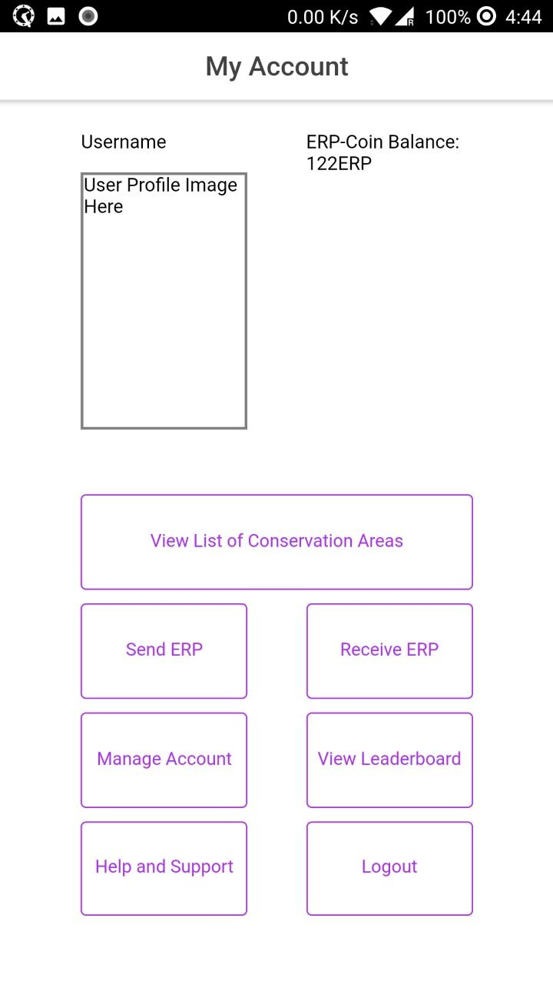
5 Mobile Application User View Account

Slide 11
Automated Testing

